Slide 1
ZERO
EXPOSURE
Securing Grand Marina's IoT Water Monitoring Pipeline
Oluwagbemileke (Gbemi) Adesiyan
Cybersecurity Extern | Livingstone College | Hydroficient | March 2026

Slide 2
THE SITUATION
A 500-Room Hotel.
Three Sensors. Zero Protection.
PRIOR INCIDENT
$4.2M
Grand Marina Hotel monitors its entire water infrastructure using three HYDROLOGIC IoT sensors transmitting live pressure, flow rate, and valve data across the hotel network — completely unprotected.
in water damage
The monitoring system that should have caught it was completely exposed.
🏢
🏊
🍽️
Main Building
Pool & Spa
Kitchen & Laundry

Slide 3
THREAT ANALYSIS
We Started With a Threat Model — Not a Guess.
Using the STRIDE framework, we mapped every possible attack vector before writing a single line of code.
Spoofing
Tampering
Repudiation
S
T
R
Fake devices impersonating sensors
Modifying sensor readings in transit
Denying malicious actions occurred
Information Disclosure
Denial of Service
Elevation of Privilege
I
D
E
Intercepting private sensor data
Overwhelming the MQTT broker
Gaining unauthorised remote control
FINDING: The unprotected pipeline was vulnerable to all six STRIDE categories simultaneously.

Slide 4
THE COMPLICATION
Three Vulnerabilities.
All Proven in Testing.
No Encryption
Result: Intercepted all sensor readings in plain text within seconds. Fully readable — no hacking tools required.
01
Test: Ran a single command on the hotel network.
No Device Identity
Result: Accepted immediately. The broker couldn't distinguish a genuine HYDROLOGIC sensor from a rogue device.
02
Test: Connected an unauthorised device to the broker.
No Message Authentication
Result: Subscriber accepted all 5 without a single error or warning. Replay attacks completely undetected.
03
Test: Captured 5 messages, replayed them 4 minutes later.
0 defenses active · 0 attacks blocked · 100% exposure confirmed

Slide 5
THE RESOLUTION
Six Weeks. Three Security Layers.
Zero Exposure.
From wide open → fully defended in six weeks.
WEEK 4
🔒 TLS Encryption
Encrypted the communication channel. Nobody can read sensor data in transit.
WEEK 5
🪪 mTLS Device Identity
Every device proves who it is. Unauthorised devices rejected at the door.
WEEK 6
🛡️ Replay Attack Protection
HMAC-SHA256 + timestamp + sequence counter. Every message verified as fresh and untampered.
WEEK 7
📊 GbemiShield Dashboard
Everything visible in real time. Live sensor data and attack alerts on one screen.

Slide 6
WEEK 4 EVIDENCE
TLS Encryption — Proven Results
Eavesdropping Test
BLOCKED
“WinError 10061 — connection refused before any data exchanged”
0.16%
0.08ms
TLS latency overhead
Added per message
Wrong CA Test
REJECTED
“CERTIFICATE_VERIFY_FAILED — impersonation attempt caught”
50 msg/s
4/4
No Verification Test
RISK IDENTIFIED
“Proved cert validation must always be enforced”
Peak load — handled
Security tests passed

Slide 7
WEEK 5 EVIDENCE
mTLS Device Identity — 4/4 Tests Passed
A. Valid certificate connects
✓ PASS
Authorised devices connect normally
B. No certificate rejected
✓ PASS
Rogue devices blocked at the broker
C. Wrong CA rejected
✓ PASS
Only Grand Marina CA-signed certs accepted
D. Expired certificate rejected
✓ PASS
Certificate lifecycle enforced automatically
mTLS Benchmark: +2.5ms handshake overhead (11.5%) · 0.0ms message latency overhead · Operationally invisible

Slide 8
WEEK 6 EVIDENCE
Replay Attack Protection — 12 Experiments
Defense | Immediate Replay | Delayed Replay | Modified Replay
No Defense | 0% blocked | 0% blocked | 0% blocked
Timestamp Only | 0% blocked | 100% blocked | 0% blocked
Sequence Only | 100% blocked | 100% blocked | 0% blocked
All Three Defenses | 100% blocked | 100% blocked | 100% blocked
KEY FINDING
No single defense is sufficient. Only the combination of all three achieves 100% rejection across every attack type — including tampered data designed to hide a pipe burst.

Slide 9
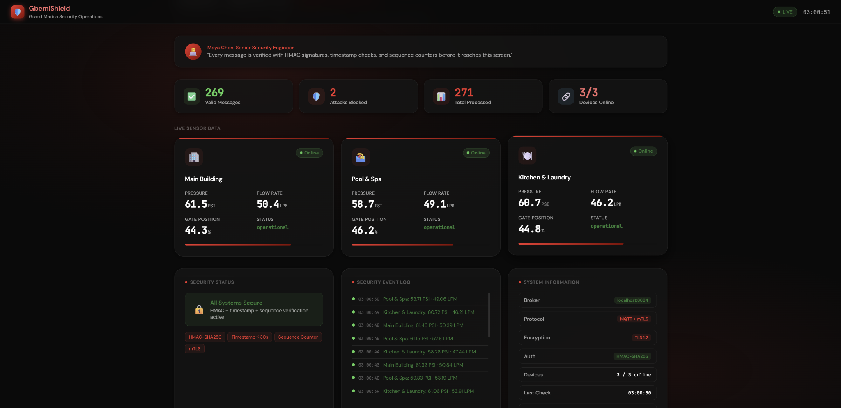
WEEK 7 EVIDENCE
GbemiShield — Live Security Dashboard
[ Insert GbemiShield Dashboard Screenshot Here ]
🟢 All three HYDROLOGIC devices live
📊 Pressure, flow rate, gate position
🔴 Real-time attack alerts
📋 Security event log
🛡️ 5 attacks blocked live during demo
🔗 WebSocket — updates without refresh

Slide 10
THE NUMBERS
Everything We Built. Proven by Data.
100%
0.16%
2.5ms
Attack rejection rate
(all three defenses)
TLS latency overhead
(negligible)
mTLS handshake overhead
(once per connection)
12
4/4
0.0ms
Controlled experiments
across 4 configurations
mTLS security
tests passed
Message latency
after connection

Slide 11
RECOMMENDATION
Enable All Three Defenses Permanently.
🔒
Keep TLS Encryption ON
Port 8883 is the minimum. The 0.16% overhead is operationally invisible against Grand Marina's 2-second publish cycle.
🪪
Keep mTLS Device Verification ON
require_certificate true in Mosquitto. The 2.5ms handshake overhead happens once per connection — not per message.
🛡️
Keep Replay Protection ON
Timestamp + sequence + HMAC must all run together. Individual defenses leave blind spots. The combination achieves 100%.
📊
Run GbemiShield Dashboard 24/7
Marcus doesn't need a terminal. The dashboard shows every attack, every alert, every device status — in real time.

Slide 12
NEXT STEPS
Where Do We Go From Here?
IMMEDIATE
30 DAYS
LONG TERM
→ Store HMAC secret in environment variable — never in source code
→ Set up automated alerts when rejection rate spikes above normal
→ Migrate HMAC secret to AWS Secrets Manager for automatic rotation
→ Enable all three defenses on all three HYDROLOGIC devices permanently
→ Expand replay protection to cover the remote shutoff command channel
→ Deploy full pipeline on AWS IoT Core infrastructure
→ Run GbemiShield dashboard 24/7 for operations team visibility
→ Document security configuration for compliance audit trail
→ Upgrade to TLS 1.3 — halves handshake time, removes weak ciphers

Slide 13
THE GAP
What Happens When Every
Check Passes — But Something
Is Still Wrong?
THE BLIND SPOT
This is what kept security engineers up at night — until AI.
Day 1
Day 2
Day 3
Day 4
Day 5
59 PSI
61 PSI
63 PSI
66 PSI
BURST
normal
normal
drifting
warning
critical
mTLS ✓ HMAC ✓ Timestamp ✓ Sequence ✓ — every rule passed. No alert fired.

Slide 14
WEEK 8 EVIDENCE
Isolation Forest — Catching
What Rules Miss
Model | Real-Time? | Needs Scaling? | Verdict
Isolation Forest | Yes ✅ | No ✅ | SELECTED
Local Outlier Factor | No ❌ | No ✅ | Batch only
One-Class SVM | Yes ✅ | Yes ⚠️ | Too slow
🟢 Green
🟠 Orange
🔴 Red
All checks passed — normal reading
AI flagged unusual pattern — investigate
Rule blocked — attack detected
Trained on 1,000 normal readings · Scores every message in real time · Catches gradual drift rules never see

Slide 15
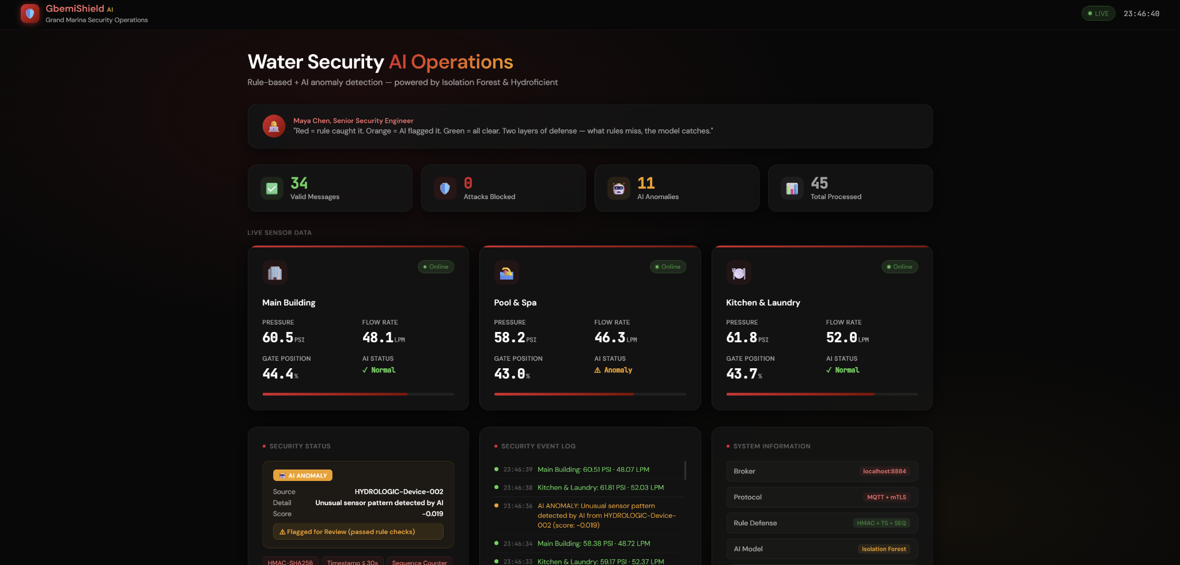

Slide 16
ZERO EXPOSURE.
Achieved.
Oluwagbemileke (Gbemi) Adesiyan
Cybersecurity Extern | Livingstone College
Hydroficient IoT Security Externship | March 2026
TLS Encryption · mTLS Device Identity · Replay Attack Protection · GbemiShield Dashboard

